Slide 1
Energy Scenario

Slide 2

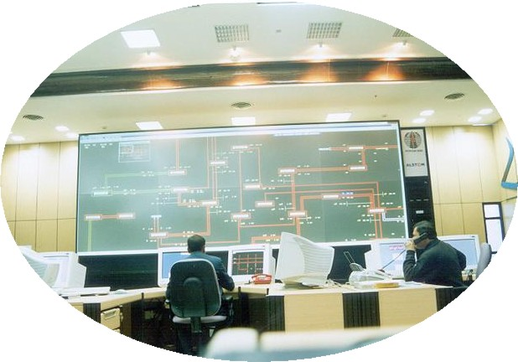
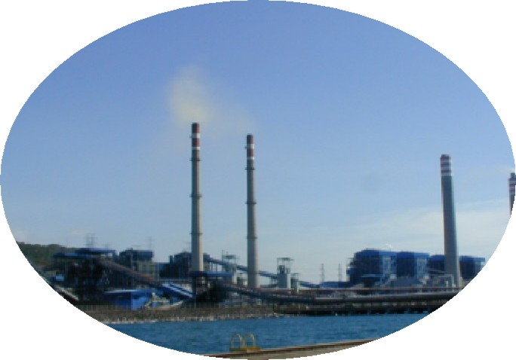

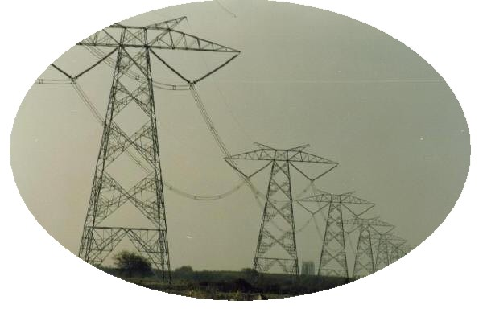

An Analogy – Power System vs Human Body
Regional Load Despatch Centre
RLDC::Brain
Generation :: Heart
USER
Sub-Transmission :: Sub-Arteries
Transmission :: Main Arteries
Distribution :: Capillaries

Slide 3
Energy Flow Diagram
PRIMARY ENERGY
COAL, OIL, SOLAR, GAS
PRIMARY ENERGY
ENERGY CONVERSION FACILITY
POWER PLANTS, REFINERIES
SECONDARY ENERGY
REFINED OIL, ELECTRICITY
SECONDARY ENERGY
TRANSMISSON & DISTN. SYSTEMS
RAILWAYS, TRUCKS, PIPELINES
FINAL ENERGY
WHAT CONSUMED BY DILIVERED
ENERGY
ENERGY UTILISATION EQUIP. & SYSTEMS
AUTOMOBILE, LAMP,MOTOR,
STOVE
USEFUL ENERGY
MOTIVE POWER, RADIENT ENERGY
END USE ACTIVITY
DISTANCE TRAVELLED, ILLUMINATION,
COOKED FOOD, ETC.

Slide 4
World net electricity generation by fuel (Trillion kWh) during 2007–2035

Slide 5
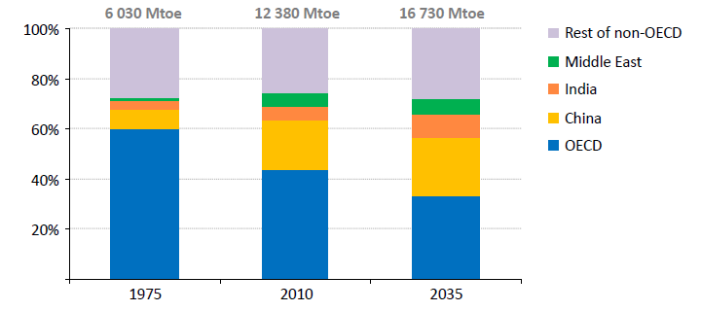
Organization for Economic Co-operation and Development
Mtoe - Million Tonnes of Oil Equivalent
energy released by burning one tonne of crude oil. approximately 42 GJ
Share of global energy demand
Global energy demand rises by over one‐third in the period to 2035,
underpinned by rising living standards in China, India & the Middle East

Slide 6
World renewable energy generation by energy source, excluding wind and hydropower, 2007–2035 (billion kWh)

Slide 7
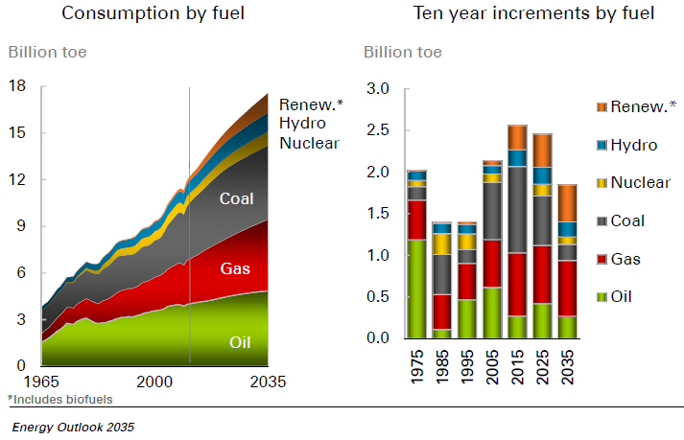

Slide 8
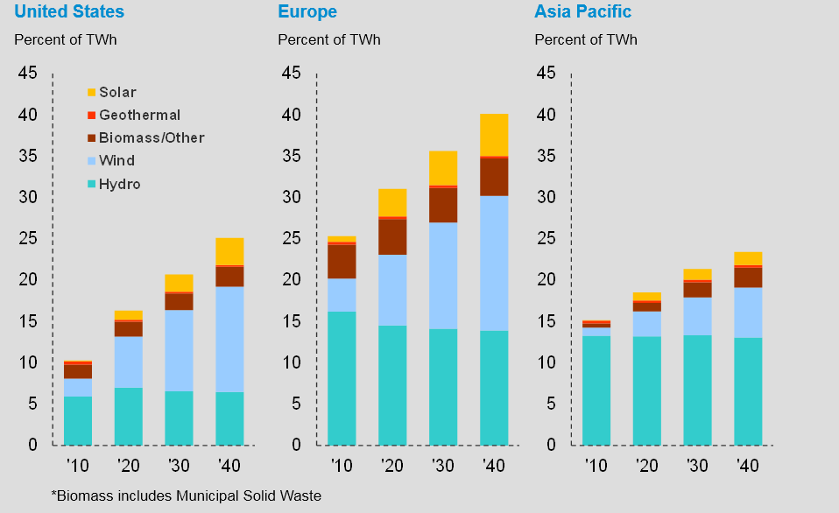
Renewables Gain Share

Slide 9
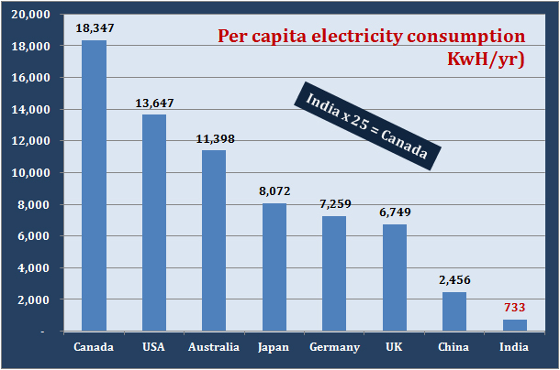
2008-09

Slide 10
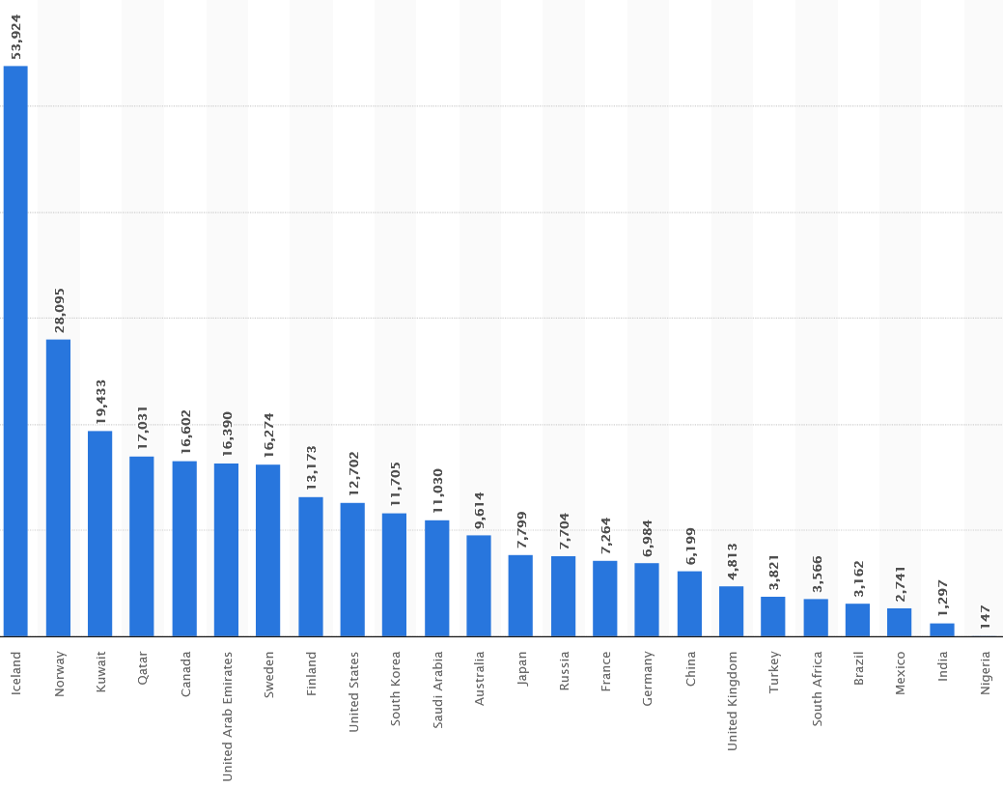
Per Capita Electricity Consumption of India (kWh/Year)
2021-22

Slide 11
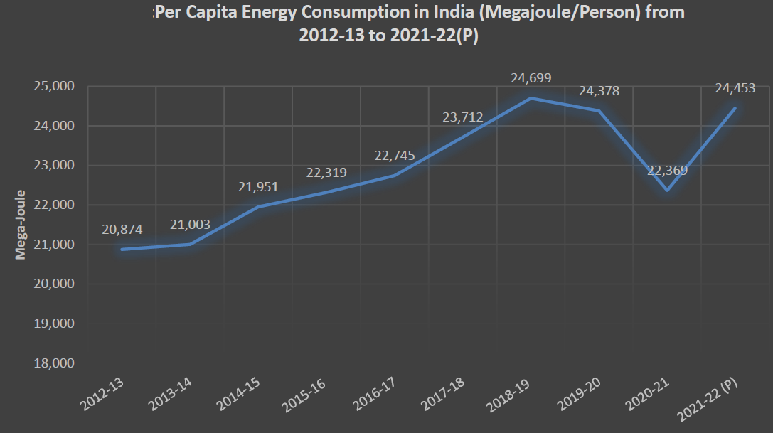
Per Capita Energy Consumption in MegaJoules in India

Slide 12
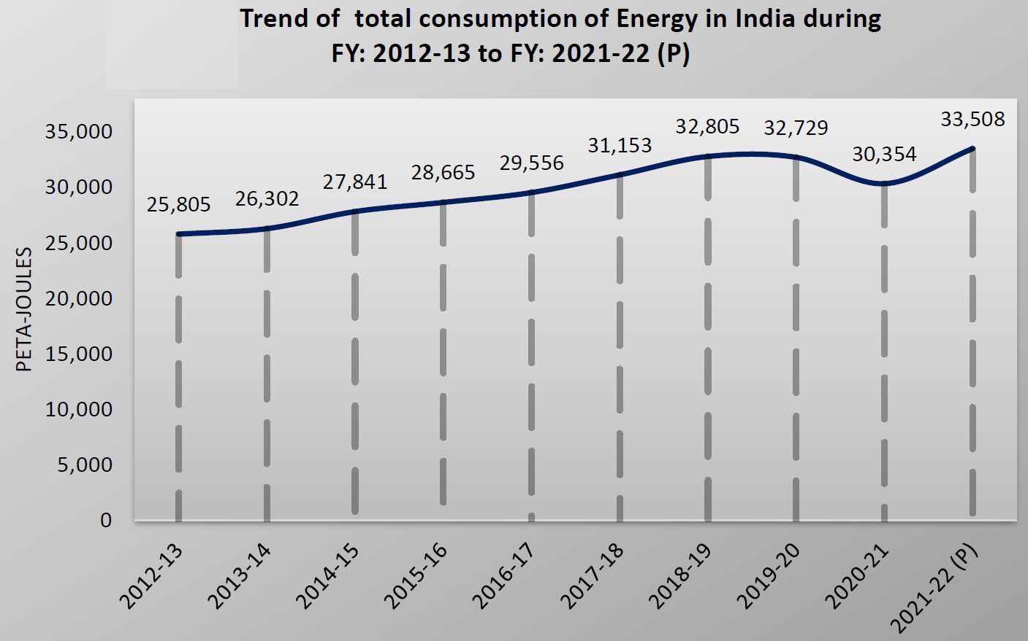
Total Energy Consumption in MegaJoules in India

Slide 13
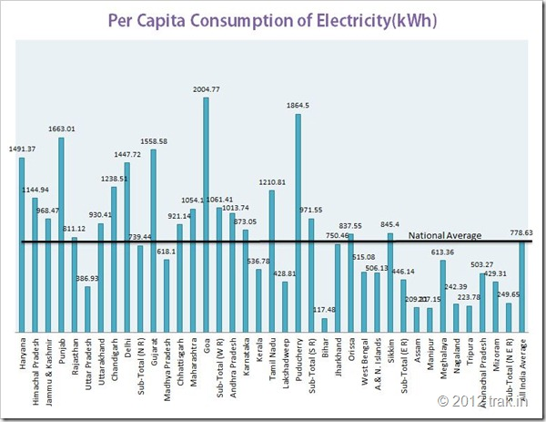

Slide 14
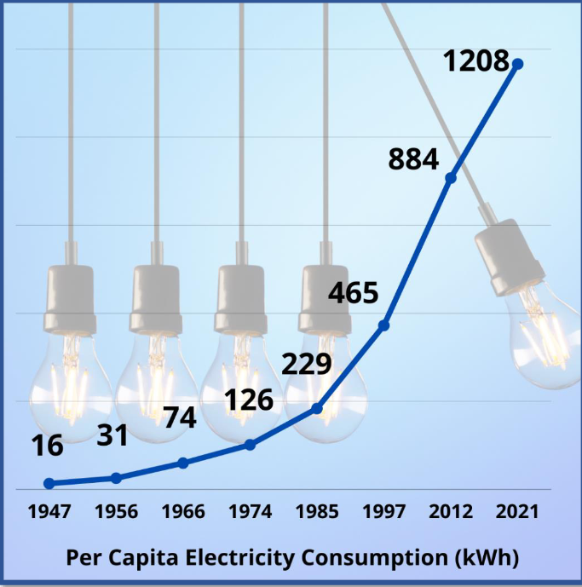

Slide 15
Plant load factor = Actual generation / Max possible
generation (rated load)
Plant Heat Rate = Heat input / Electricity output
Net Power = Gross – Auxiliary Consumption
The electricity sector in India had an installed capacity of 482.232 GW (or 1,719 TWh) as on 31 March 2022. (World 24,398 TWh)
Per capita electricity consumption of India in 2022-23 is 1255 kWh/year (world average - 3081 kWh/year)

Slide 16
State wise installed capacity in MW (2012)

Slide 17
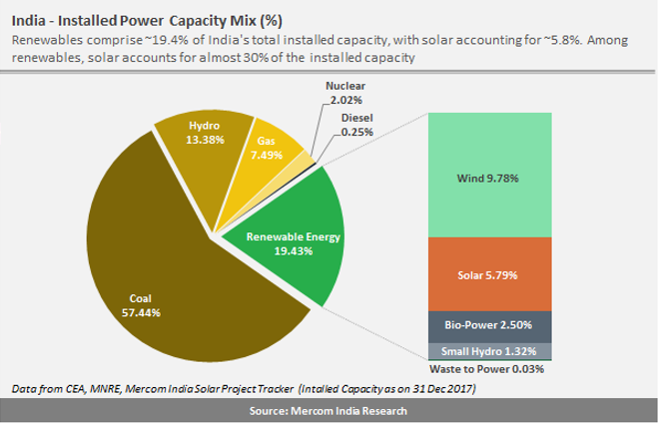

Slide 18
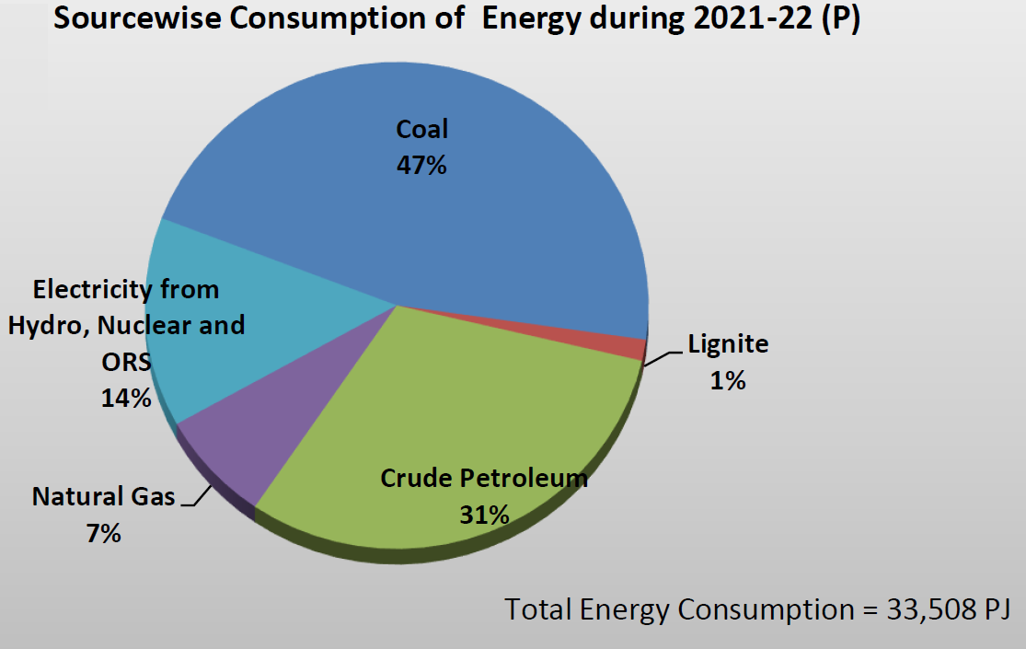

Slide 19
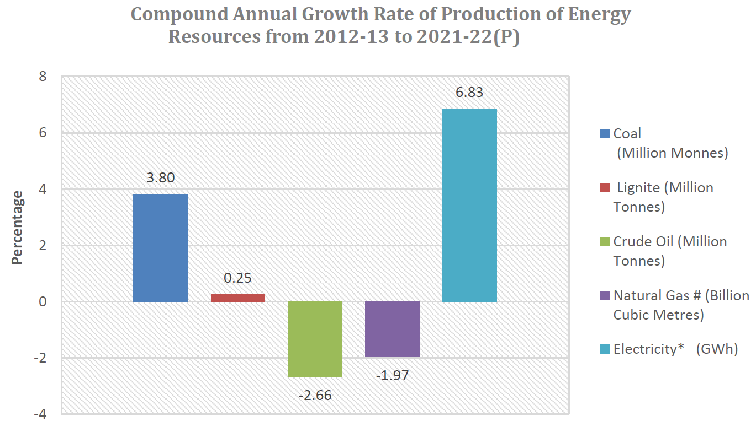
Compound Annual Growth Rate of production of of Energy resources in India

Slide 20
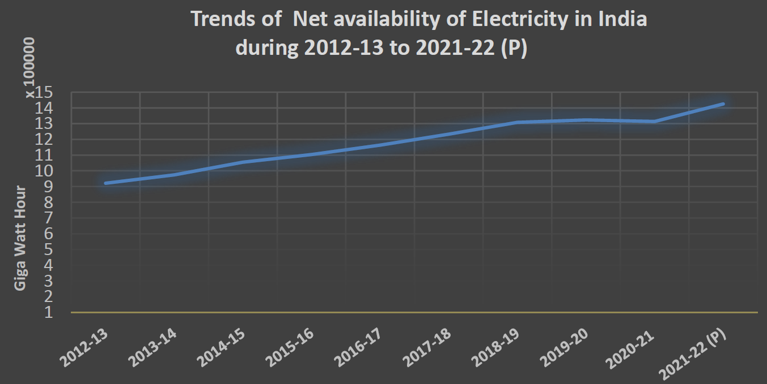
Yearwise net availability of Electricity in GWh

Slide 21
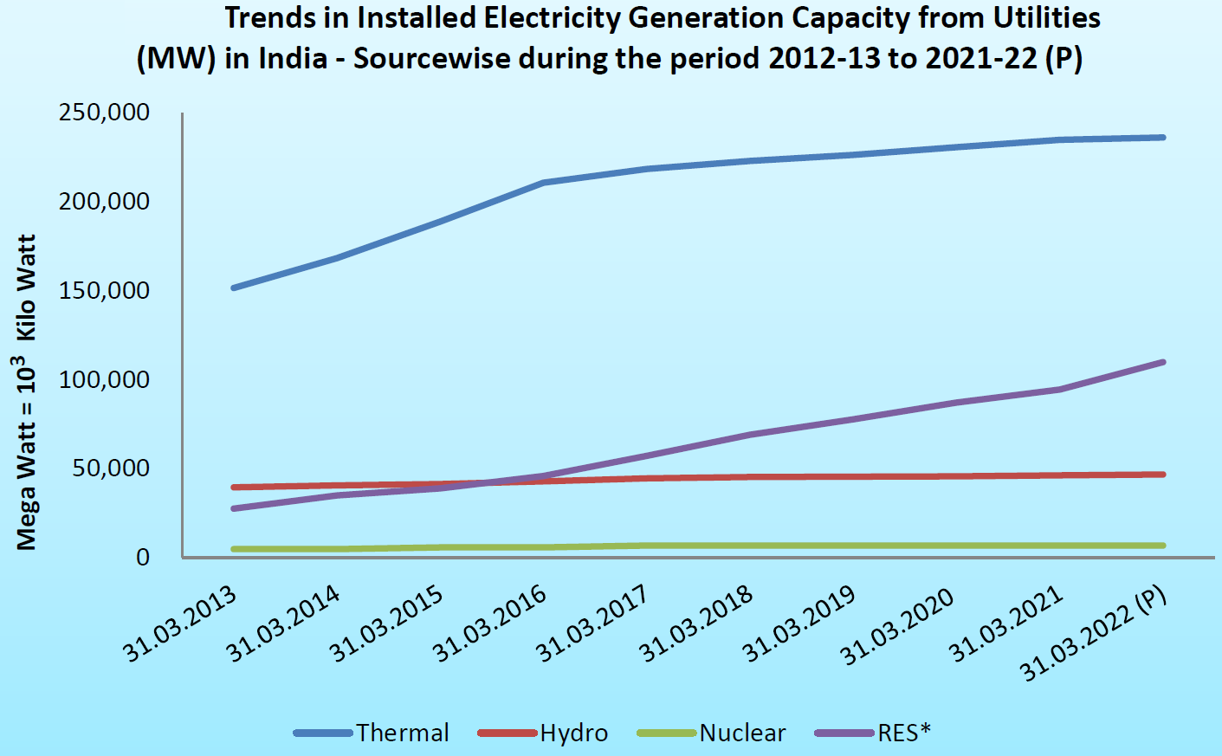
Yearwise Installed Capacity of Electricity Generation of Electricity in India (MW)

Slide 22
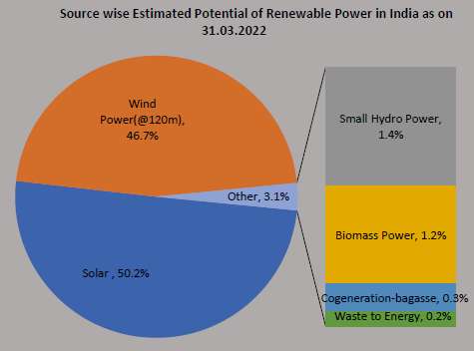
Source wise Estimated Potential of Renewable Power in INDIA

Slide 23
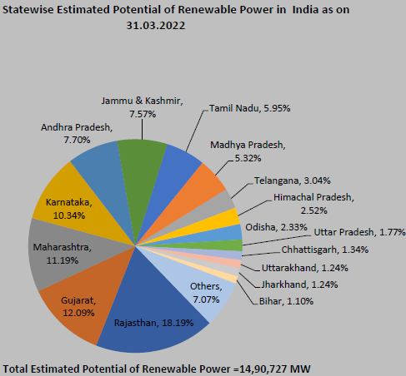
State wise Estimated Potential of Renewable Power in INDIA

Slide 24
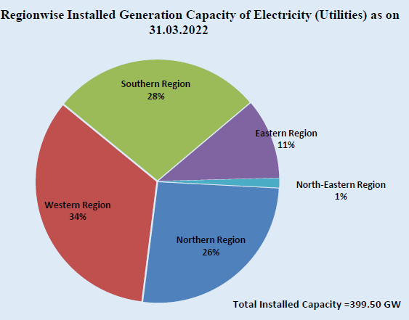
Regionwise Installed Generating Capacity of Electricity In india

Slide 25
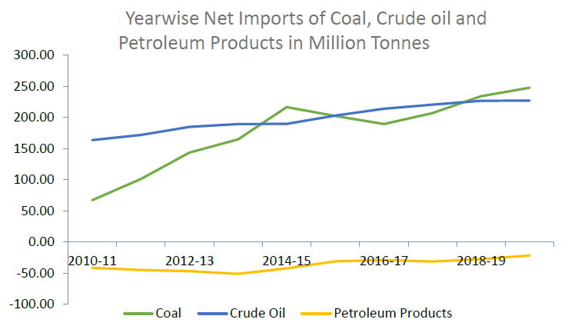
Yearwise net imports of coal, cruid oil and petroleum products in Million Tonnes in India

Slide 26
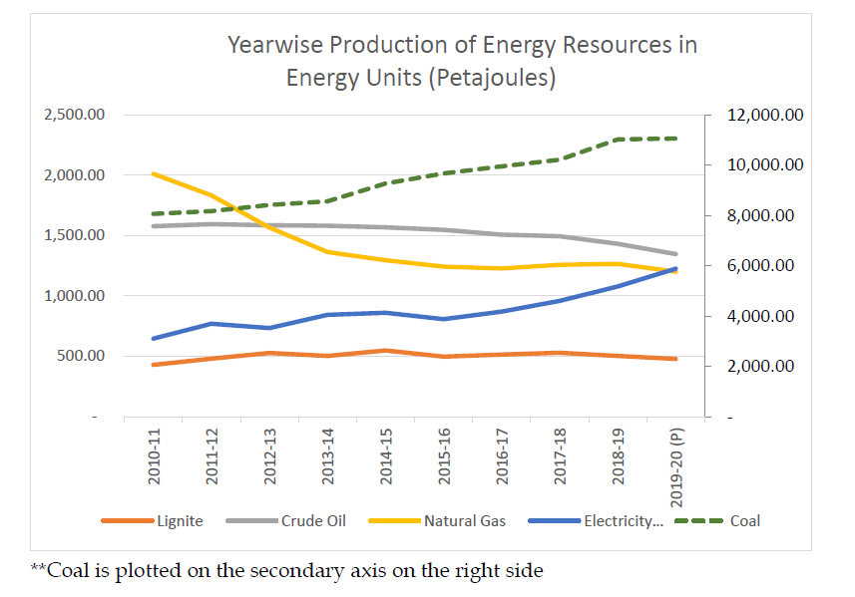
Yearwise Production of Energy Resources in Energy Units (Petajoules) in INDIA

Slide 27
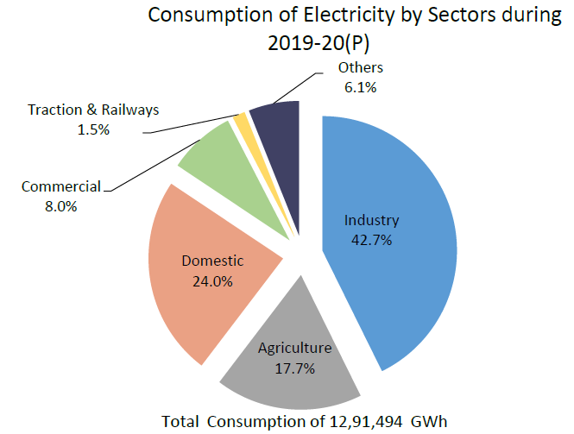
Sector wise Consumption of Electricity

Slide 28
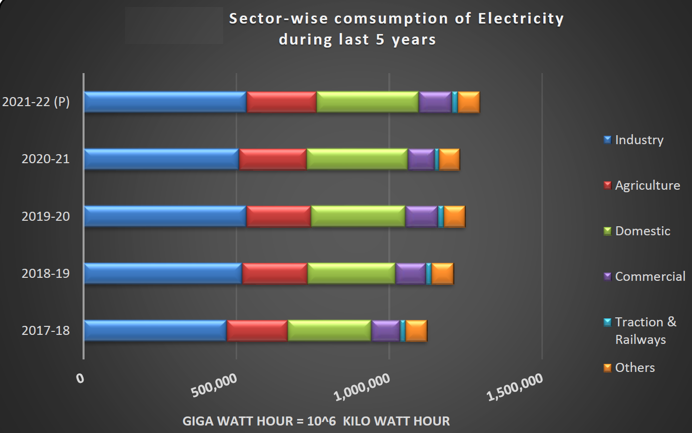
Sector wise Consumption of Electricity

Slide 29
Potential Challenges of india
i. Enhancing capacity for growth
ii. Enhancing skills and faster generation of employment
iii. Managing the environment
iv. Markets for efficiency and inclusion
v. Decentralization, Empowerment and Information
vi. Technology and innovation
vii. Securing the energy future for India
viii. Accelerated development of transport infrastructure
ix. Rural Transformation and Sustained Growth of Agriculture
x. Managing Urbanization
xi. Improved access to Quality Education
xii. Better preventive and curative healthcare

Slide 30
Thank you

